Slide 1

Factors Influencing Taxi-Out Time at Newark Liberty International Airport (EWR)
Matt Cohen, Krupali Kothari, Khushi Patel, Sriya Vemuri

Slide 2

Research Question
What operational, congestion, and weather factors influence taxi-out time at Newark Airport in June 2024?
Taxi-out affects both passengers and airport operations
Taxi-out time is a direct measure of ground movement
  Longer taxi-out times → ground congestion, operational inefficiency
  Understanding these drivers can help improve airport scheduling and runway operations

Slide 3


Data Collection Process
Bureau of Transportation Statistics (BTS) Reporting Carrier On-Time Performance
National Oceanic and Atmospheric (NOAA) Integrated Surface Database
Domestic flight data in the US
Original dataset of domestic flights to and from EWR in June 2024
Hourly weather balloon data in the US
Original dataset from EWR weather balloon in 2024

Slide 4

Data Cleaning and Merging
Step 1: Filter Flight Data
  Kept EWR departures for June 2024
  Removed cancelled flights and missing records
  Parsed flight date/time features
Step 2: Engineer Operational Variables
  Created peak-hour and weekend indicators
  Built congestion variables using previous 15- and 60-minute departure activity
  Counted surface congestion at departure time
Step 3: Merge Weather Data
  Matched each flight to the nearest hourly weather record
  Created weather flags: rain, fog, and low ceiling
  Final dataset: 9,327 rows and 28 columns

Slide 5

Notable Limitations
Runway Assignment Not Included
  Different runways can affect taxi distance and takeoff sequencing
Gate Information Not Included
  Gate location affects how long aircraft spend taxiing before takeoff
Limited to Domestic Departures
  EWR also handles international traffic, which may affect overall runway congestion but is not fully captured here
These missing operational factors help explain why the model has moderate, not perfect, predictive power.

Slide 6
Key Variables
Response Variable (Y):
  TAXI_OUT: time in minutes from gate departure to wheels-off
Predictors (X):
  Congestion:
    CONGESTION_15M, CONGESTION_60M, CONGESTION_SURFACE_AT_DEP, REL_CONG_15M, REL_CONG_60M
  Time
    HOUR_OF_DAY, DAY_OF_WEEK, IS_PEAK_HOUR
  Weather
    TMP_C, DEW_C, SLP_hPa, WindSpeed_ms, VIS_m, RAIN_FLAG
  Flight
    DISTANCE

Slide 7
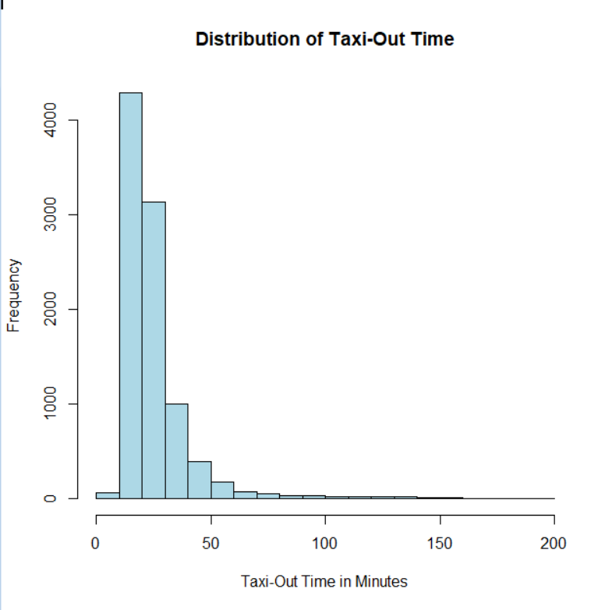
Taxi-Out Time is Right-Skewed
Most flights had taxi-out times around 10-40 minutes
The distribution is right-skewed.
A smaller number of flights had a very long taxi-out times, reaching over 100 minutes.

Slide 8
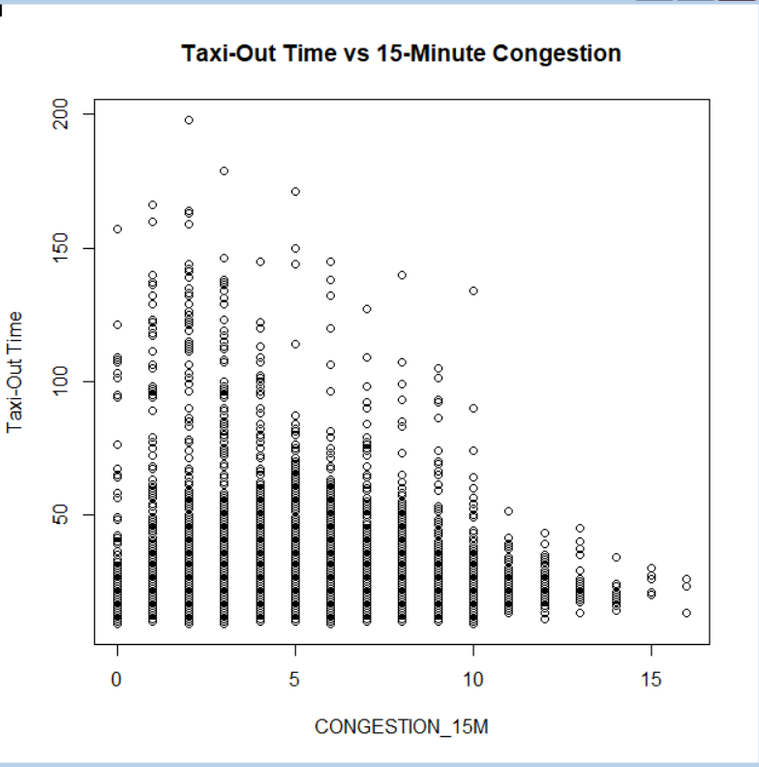
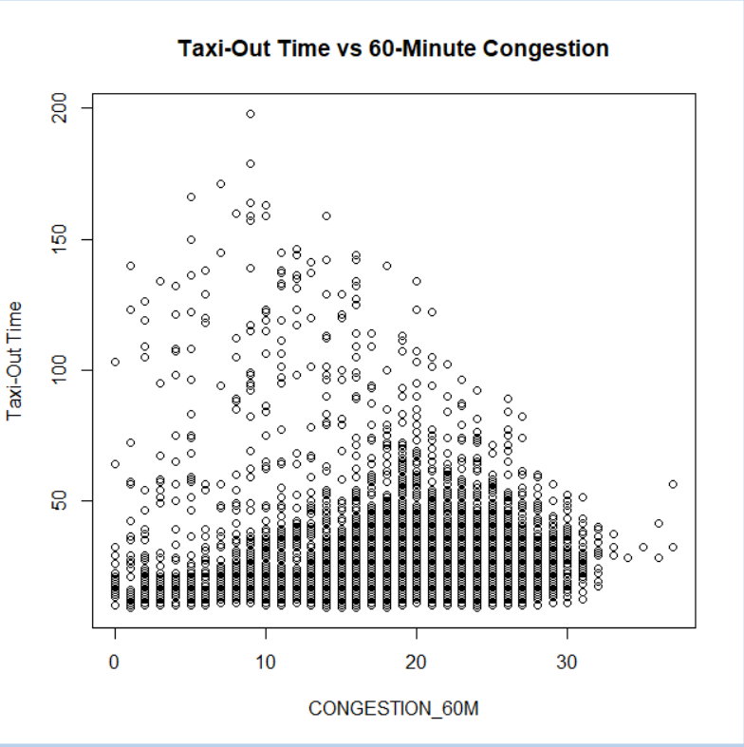
Congestion and Taxi-Out Time
Taxi-out time varies more when congestion levels are higher.
The relationship is not perfectly linear, but congestion appears important.
60-minute congestion becomes significant in the regression model.

Slide 9
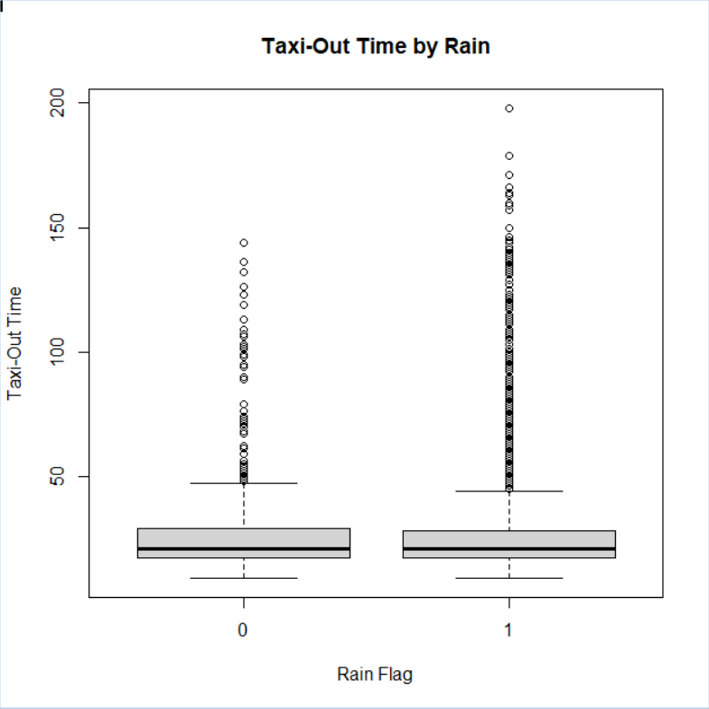
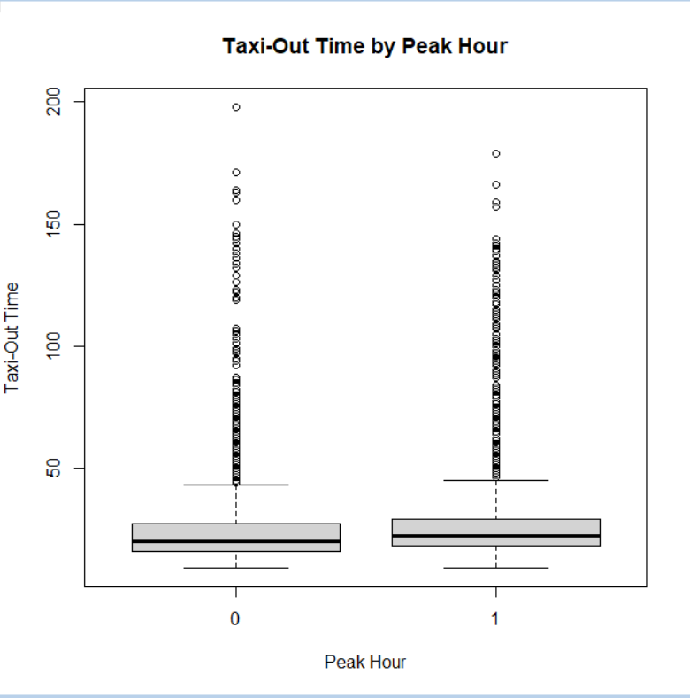
Taxi-Out Time by Peak Hour and Rain
Rainy conditions show greater spread and more extreme taxi-out times.
Peak-hour flights show a slightly higher median taxi-out time.
Both variables are relevant for modeling airport ground operations.

Slide 10

Regression Modeling Strategy
Model 1: Full Model
  Included all meaningful predictors from time, congestion, weather, and flight categories
Model 2: Stepwise Final Model
  Used stepwise selection to remove weaker predictors
  Final model was selected using AIC
Why we used two models:
  Full model shows the complete starting relationship
  Stepwise model improve interpretability while keeping important predictors

Slide 11
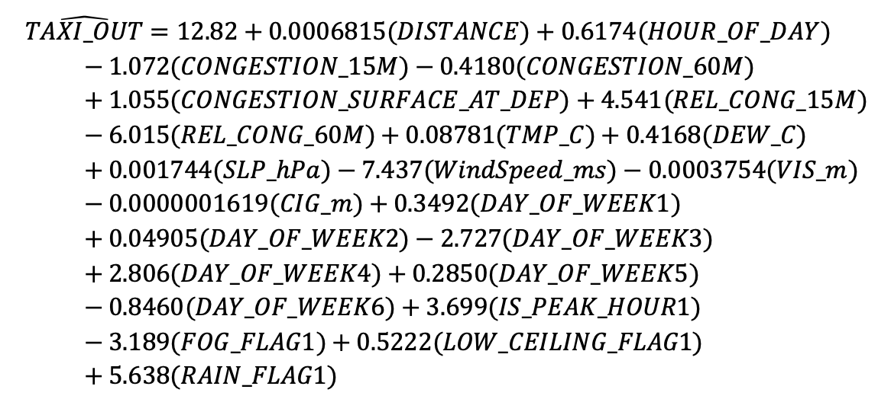
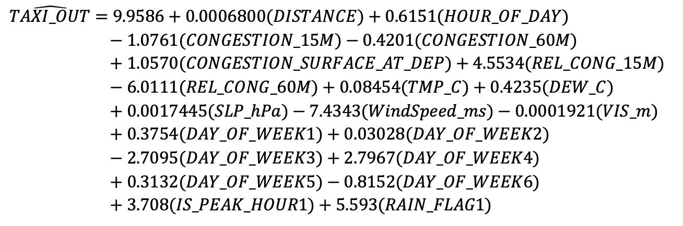


Models
Model 1 – Full Model
Model 2 – Final Model
$$R^{2}=0.3235$$
$${adj. R}^{2}=0.3219$$
$$R^{2}=0.3234$$
$${adj. R}^{2}=0.322$$

Slide 12
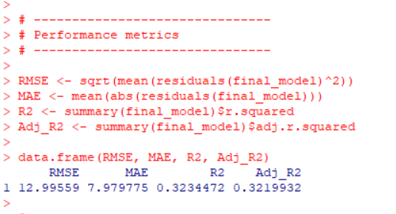
Final Regression Model Performance
The model explains about 32.2% of taxi-out time variation.
The overall regression model is statistically significant.
Prediction error is about 8 minutes on average using MAE.

Slide 13
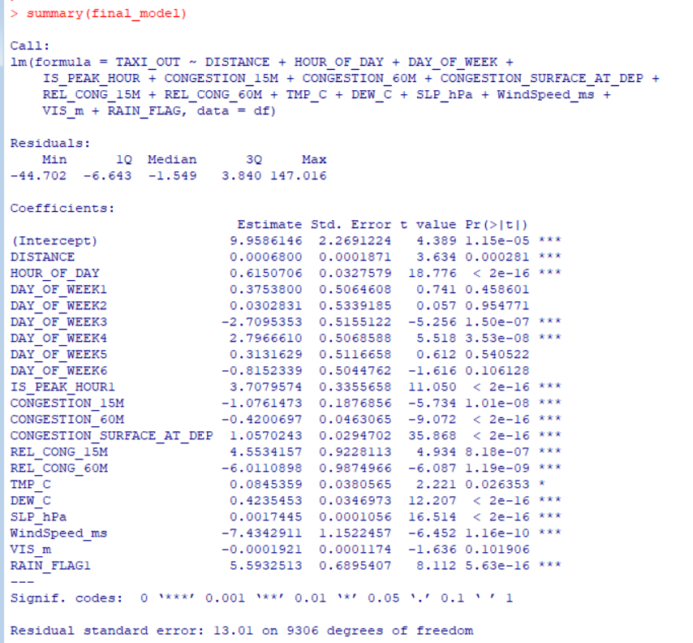
Key Drivers of Taxi-Out Time
Strong significant predictors:
  HOUR_OF_DAY
  IS_PEAK_HOUR
  CONGESTION_60M
  CONGESTION_SURFACE_AT_DEO
  REL_CONG_60M
  TMP_C
  DEW_C
  SLP_hPa
  WindSpeed_ms
  RAIN_FLAG
Congestion and operational timing are the strongest predictors of taxi-out time.

Slide 14
Coefficient Interpretation
PREDICTOR | DIRECTION | INTERPRETATION
CONGESTION_SURFACE_AT_DEP | Positive | More aircraft taxiing increases taxi-out time
IS_PEAK_HOUR | Positive | Peak-hour departures have longer taxi-out times
RAIN_FLAG | Positive | Rain is associated with longer taxi-out time
HOUR_OF_DAY | Positive | Later hours are associated with longer taxi-out time
CONGESTION_60M | Negative in final model | Interpreted carefully due to overlap with other congestion variables
Important note:
  Some congestion variables are related to each other, so coefficients should be interpreted as adjusted effects, holding other variables constant.

Slide 15
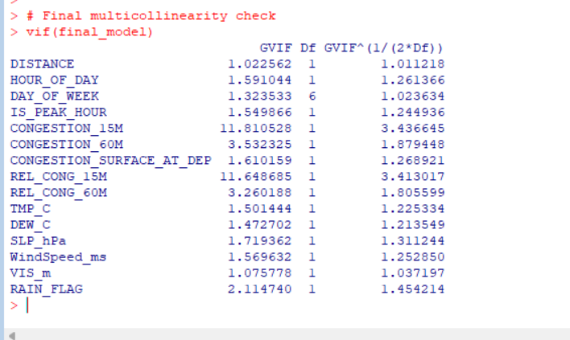
Multicollinearity Assessment
Most adjusted VIF values were close to 1-2.
Congestion variables had higher values, but still acceptable after adjustment.
No severe multicollinearity problem was found in the final model.

Slide 16
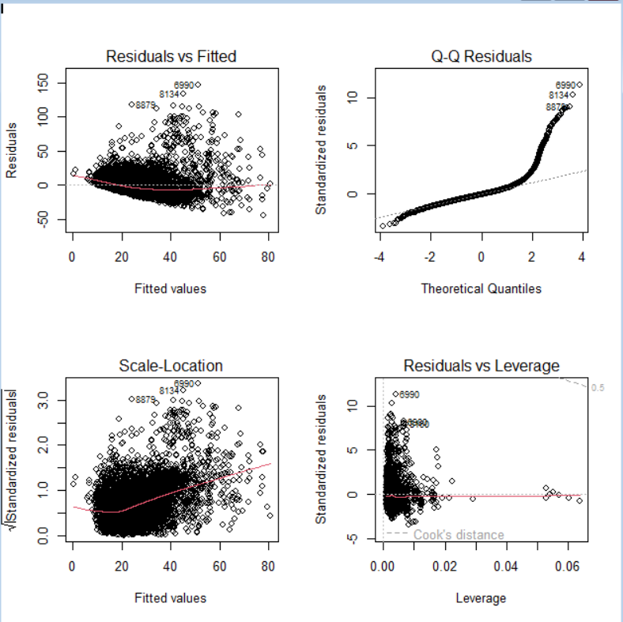
Regression Diagnostics
Findings:
  Residuals vs fitted plot shows some funnel shape
  Q-Q plot shows right-tail deviation.
  Scale-location plot suggests non-constant variance.
  A few influential points exist, but more observations are stable.
Interpretation:
  The model is useful, but assumptions are not perfectly satisfied due to skewed taxi-out times and extreme operational cases.

Slide 17
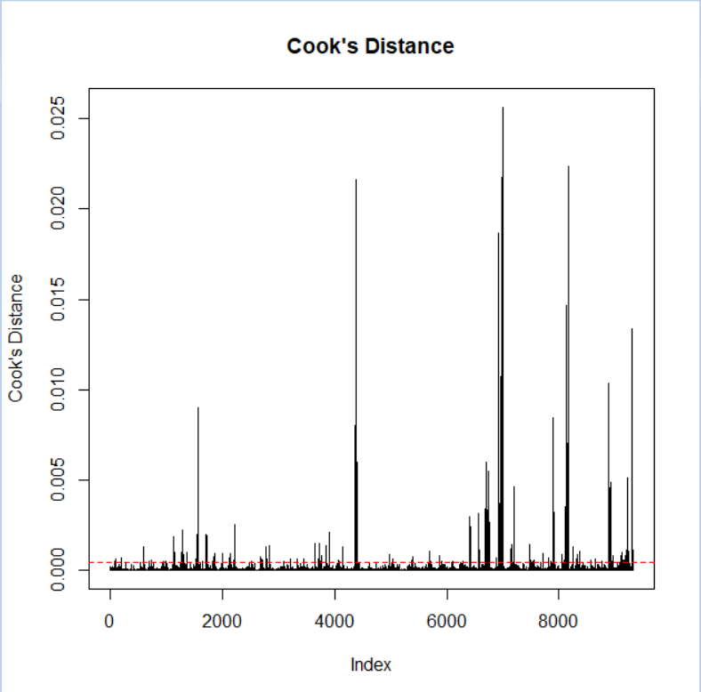
Outliers and Influence
Several observations had high studentized residuals.
Cook's distance identified a few influential observations.
These were not automatically removed because they may represent real airport events.

Slide 18
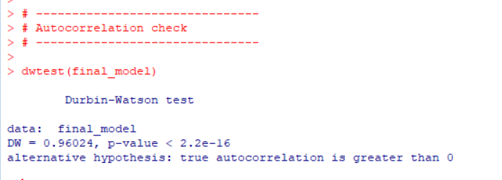
Autocorrelation Check
Durbin-Watson statistic: 0.96
Indicates positive autocorrelation
This likely occurs because flights close in time are affected by similar airport conditions.

Slide 19
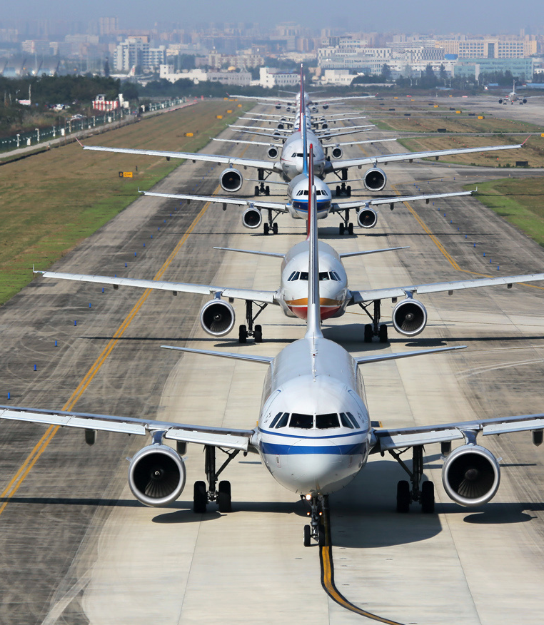
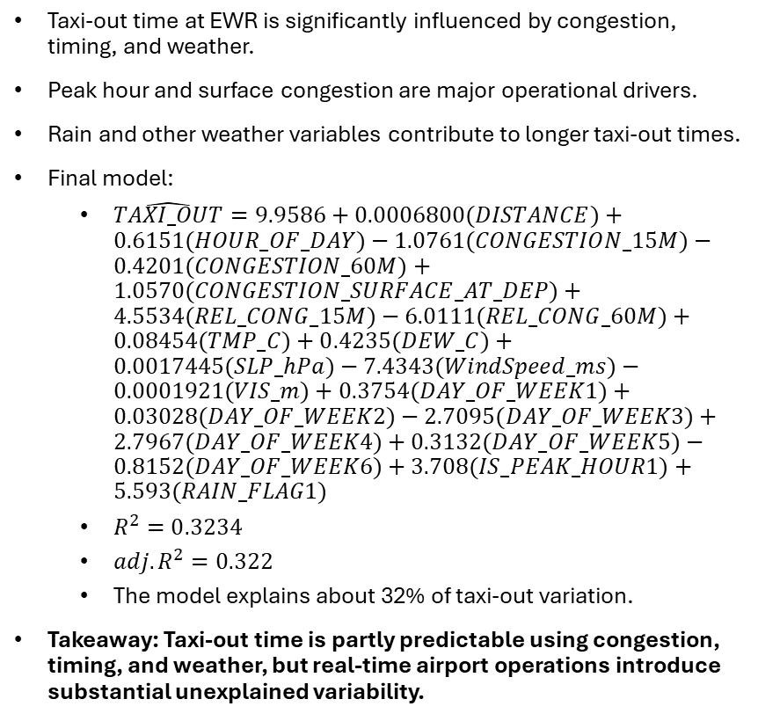
Conclusion
Taxi-out time at EWR is significantly influenced by congestion, timing, and weather.
Peak hour and surface congestion are major operational drivers.
Rain and other weather variables contribute to longer taxi-out times.
Final model:
  $\hat{TAXI_OUT}=9.9586+0.0006800(DISTANCE)+0.6151(HOUR_OF_DAY)−1.0761(CONGESTION_15M)−0.4201(CONGESTION_60M)+1.0570(CONGESTION_SURFACE_AT_DEP)+4.5534(REL_CONG_15M)−6.0111(REL_CONG_60M)+0.08454(TMP_C)+0.4235(DEW_C)+0.0017445(SLP_hPa)−7.4343(WindSpeed_ms)−0.0001921(VIS_m)+0.3754(DAY_OF_WEEK1)+0.03028(DAY_OF_WEEK2)−2.7095(DAY_OF_WEEK3)+2.7967(DAY_OF_WEEK4)+0.3132(DAY_OF_WEEK5)−0.8152(DAY_OF_WEEK6)+3.708(IS_PEAK_HOUR1)+5.593(RAIN_FLAG1)$
  $R^{2}=0.3234$
  ${adj. R}^{2}=0.322$
  The model explains about 32% of taxi-out variation.
Takeaway: Taxi-out time is partly predictable using congestion, timing, and weather, but real-time airport operations introduce substantial unexplained variability.

